Slide 1
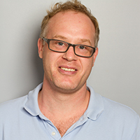
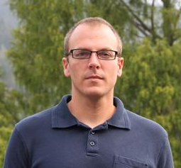
Efficient online quantum state estimation using a matrix-exponentiated gradient method
Akram Youssry^{1,2}, Christopher Ferrie¹, and Marco Tomamichel²
Akram Youssry et al 2019 New J. Phys. 21 033006
¹University of Technology Sydney, Centre for Quantum Software and Information, Ultimo NSW 2007, Australia
²Department of Electronics and Communication Engineering, Faculty of Engineering, Ain Shams University, Cairo, Egypt

Slide 2




Quantum State Estimation
Quantum System
Measurement
Classical Data
State Estimate
$$ρ$$
$${\left\{X_{t}\right\}}_{t=0}^{T−1}$$
$${\left\{{\hat{y}}_{t}\right\}}_{t=0}^{T−1}$$
$$\hat{ρ}$$

Slide 3















Batch VS Online Estimation
Time ☹
$$\left(X_{1},{\hat{y}}_{1}\right)$$
Estimation Algorithm
$$\left(X_{2},{\hat{y}}_{2}\right)$$
$$\hat{ρ}$$
$$⋮$$
$$⋮$$
$$\left(X_{T},{\hat{y}}_{T}\right)$$
Batch Estimation
Space ☹
$$\left(X_{1},{\hat{y}}_{1}\right)$$
Estimation Algorithm
$$\left(X_{2},{\hat{y}}_{2}\right)$$
Estimation Algorithm
$$⋯$$
$$\left(X_{T},{\hat{y}}_{T}\right)$$
Estimation Algorithm
$${\hat{ρ}}_{1}$$
$${\hat{ρ}}_{2}$$
$$⋯$$
$${\hat{ρ}}_{T}$$
$${\hat{ρ}}_{T+1}$$
Online Estimation

Slide 4
Problem Statement
Quantum State Estimation Algorithm
Online
Efficient
Convergence Proof

Slide 5
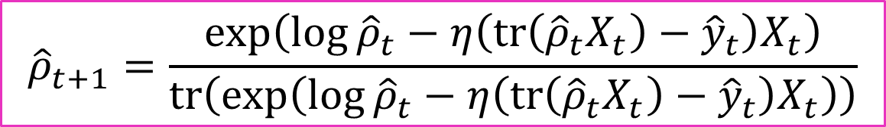
Theoretical Results: MEG Update Rule
Old estimate
Measurement operator
New estimate
Learning rate
Measurement outcome
$${\hat{ρ}}_{t+1}{=\frac{\exp\left(\log{{\hat{ρ}}_{t}}−η\left(tr\left({\hat{ρ}}_{t}X_{t}\right)−{\hat{y}}_{t}\right)X_{t}\right)}{tr\left(\exp\left(\log{{\hat{ρ}}_{t}}−η\left(tr\left({\hat{ρ}}_{t}X_{t}\right)−{\hat{y}}_{t}\right)X_{t}\right)\right)}}$$
Matrix-Exponentiated Gradient (MEG) Update Rule
Gradient of the loss function

Slide 6
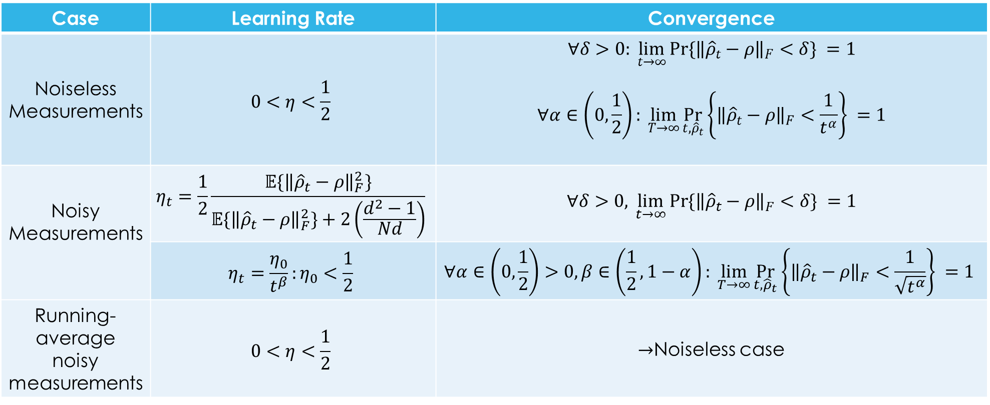
Theoretical Results: Learning Rate
Case | Learning Rate | Convergence
Noiseless Measurements | $$0<η<\frac{1}{2}$$ | $$∀δ>0:\lim_{t→∞}{Pr\{{\left\|{\hat{ρ}}_{t}−ρ\right\|}_{F}<δ\} }=1$$ $$∀α∈\left(0,\frac{1}{2}\right):\lim_{T→∞}{\underset{t,{\hat{ρ}}_{t}}{Pr}\left\{{\left\|{\hat{ρ}}_{t}−ρ\right\|}_{F}<\frac{1}{t^{α}}\right\} }=1$$
Noisy Measurements | $$η_{t}=\frac{1}{2}\frac{𝔼\{{\left\|{\hat{ρ}}_{t}−ρ\right\|}_{F}^{2}\}}{𝔼\{{\left\|{\hat{ρ}}_{t}−ρ\right\|}_{F}^{2}\}+2\left(\frac{d^{2}−1}{Nd}\right)}$$ | $$∀δ>0,\lim_{t→∞}{Pr\{{\left\|{\hat{ρ}}_{t}−ρ\right\|}_{F}<δ\} }=1$$
 | $$η_{t}=\frac{η_{0}}{t^{β}}:η_{0}<\frac{1}{2}$$ | $$∀α∈\left(0,\frac{1}{2}\right)>0,β∈\left(\frac{1}{2},1−α\right):\lim_{T→∞}{\underset{t,{\hat{ρ}}_{t}}{Pr}\left\{{\left\|{\hat{ρ}}_{t}−ρ\right\|}_{F}<\frac{1}{\sqrt{t^{α}}}\right\} }=1$$
Running- average noisy measurements | $$0<η<\frac{1}{2}$$ | $→$Noiseless case

Slide 7

Numerical Results I: Learning Rate
1-Qubit system & 100 shots per measurement, $η=0.5t^{−β}$
https://github.com/akramyoussry/MEG_online_QST

Slide 8
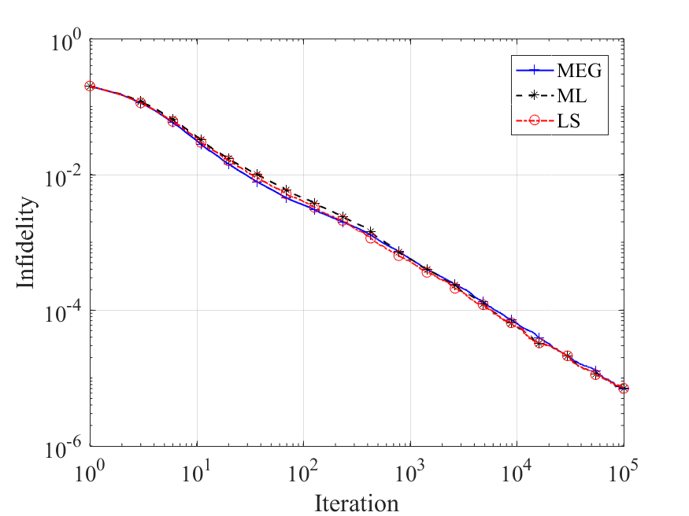
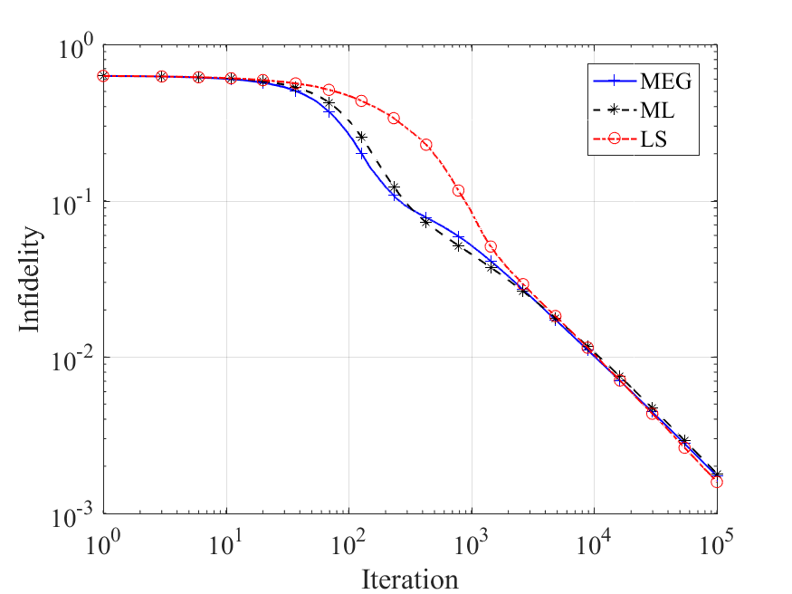
Numerical Results II: Accuracy
1 Qubits & 10 shots per measurements
4 Qubits & 1000 shots per measurement
https://github.com/akramyoussry/MEG_online_QST

Slide 9
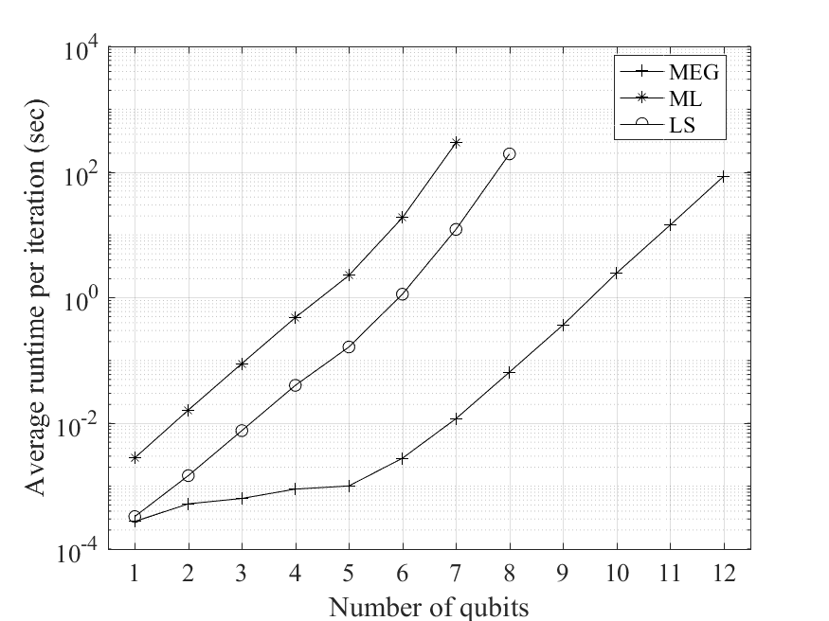
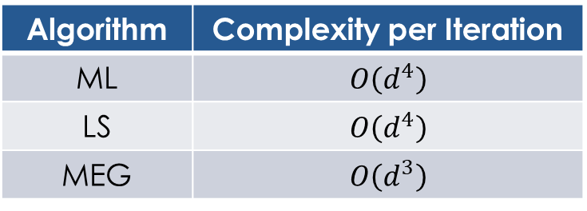
Numerical Results III: Complexity
Algorithm | Complexity per Iteration
ML | $$O\left(d^{4}\right)$$
LS | $$O\left(d^{4}\right)$$
MEG | $$O\left(d^{3}\right)$$

Slide 10
Conclusions
We ported MEG into the Quantum world!
We proved convergence for both noiseless and noisy measurements.
We numerically compared the proposed algorithm with other standard techniques and showed that it is as accurate but much more efficient.
The paper is published here: (Akram Youssry et al 2019 New J. Phys. 21 033006) please check it ☺

Slide 11

Thanks
☺ ☺ ☺

